Slide 1
Evaluating the Robustness of Bayesian Neural Networks By Exploiting Uncertainty Estimation
Università degli Studi di Bergamo
Dipartimento di ingegneria Gestionale, dell’informazione della produzione
Relatore:
Prof. Angelo Gargantini
Candidato:
Wasim Essbai
Correlatori:
Dott. Andrea Bombarda
Dott.ssa Silvia Bonfanti
Anno Accademico 2022-2023

Slide 2
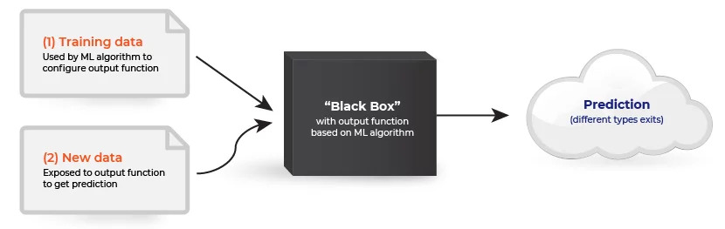
Introduzione
Impiego di modelli di machine learning in diversi settori, spesso eseguendo funzioni critiche
Apprendimento direttamente dai dati
Utilizzo a scatola nera
ma…
Se i dati non sono rappresentativi?
Se ci sono perturbazioni nelle condizioni operative?
Robustezza

Slide 3
Obiettivi
Come valutare la robustezza delle reti neurali bayesiane (BNN)?
Le BNN sono più robuste delle reti neurali standard?
Si può usare la stima di incertezza per avere modelli più robusti?

Slide 4

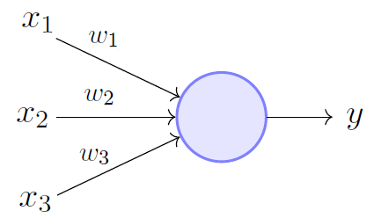
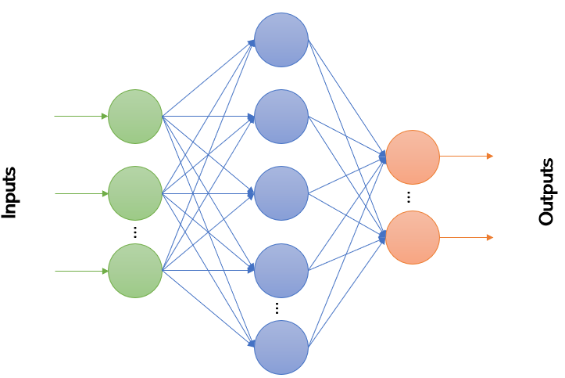
Reti neurali
Neuron artificiale
Layer

Slide 5
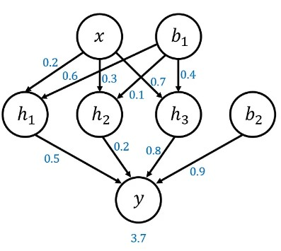
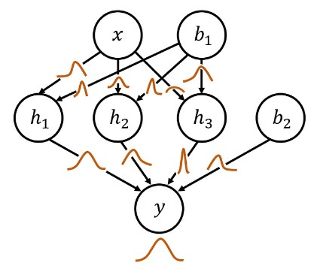
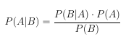
Reti neurali bayesiane
Teorema di Bayes

Slide 6
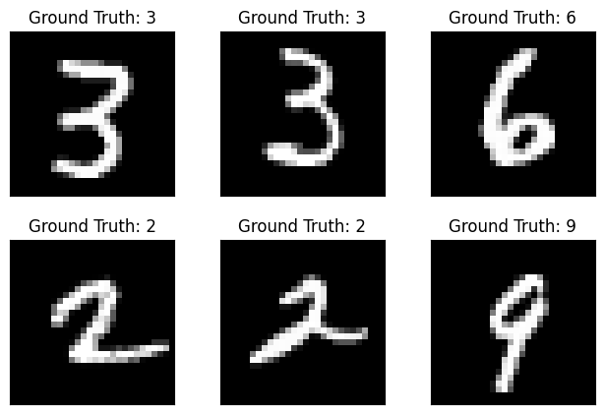
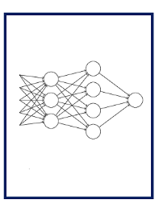
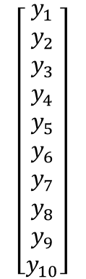
Caso di studio
Classificazione di immagini
Dataset: MNIST
Architettura della rete:
Multilayer Perceptron (MLP)
Input layer: 784 neuroni
Hidden layer: 100 neuroni
Output layer: 10 neuroni
$$\left[\begin{aligned}y_{1} \\ y_{2} \\ y_{3} \\ y_{4} \\ y_{5} \\ y_{6} \\ y_{7} \\ y_{8} \\ y_{9} \\ y_{10}\end{aligned}\right]$$

Slide 7
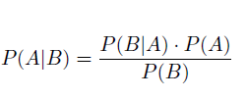
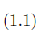
Bayesian Neural Networks
A standard network
Why?
Bayesian network
Uncertainty estimation!
Aleatoric: Related to the inputs
Espistemic: Related to the model
Bayes’ Theorem

Slide 8


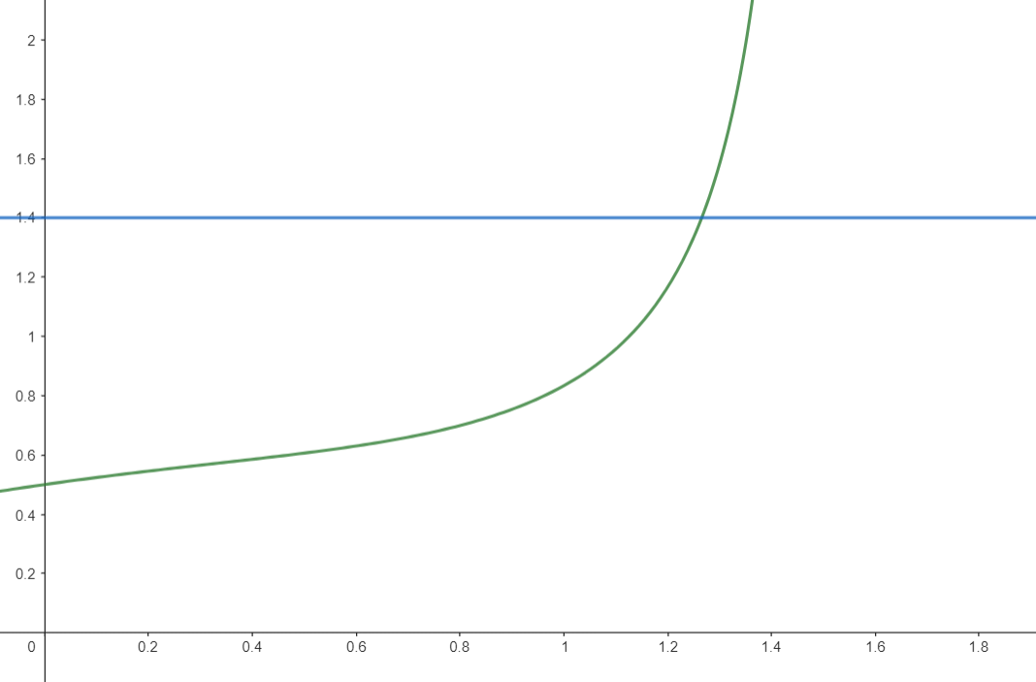
Classification using uncertainty
How to define the threshold?
e.g.
Prediction
A possible choice is a linear approximation
BNN
Input
$$threshold=maxUnc(1−conf_level)$$
I don’t know
??
Idea:
Whenever the uncertainty surpasses a defined threshold the network outputs an unknown statement.

Slide 9
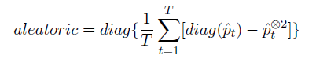
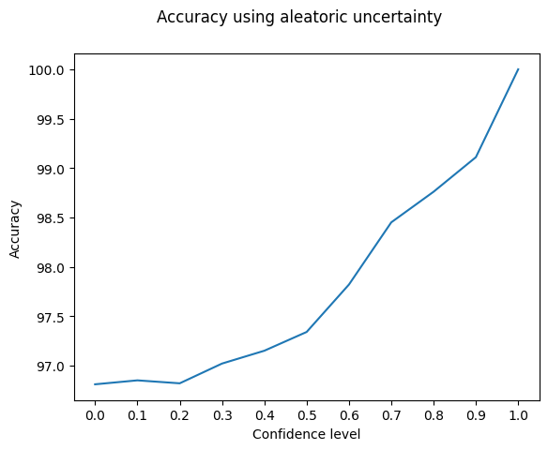
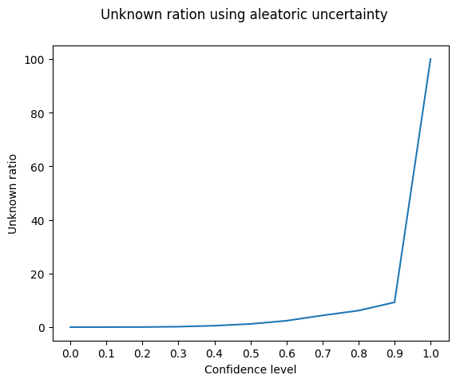
Aleatoric uncertainty
$$threshold=0.9(1−conf_level)$$

Slide 10
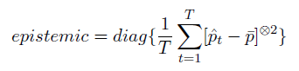
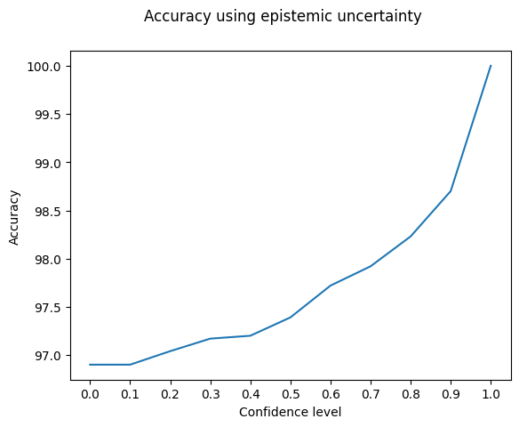
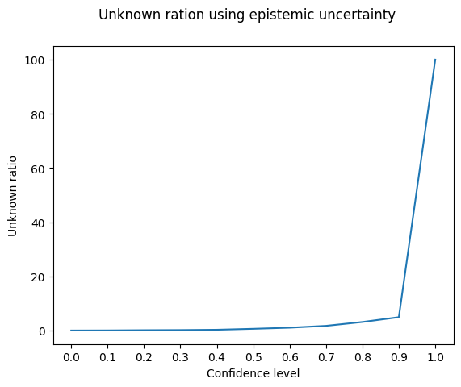
Epistemic uncertainty
$$threshold=0.2(1−conf_level)$$

Slide 11
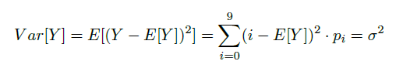
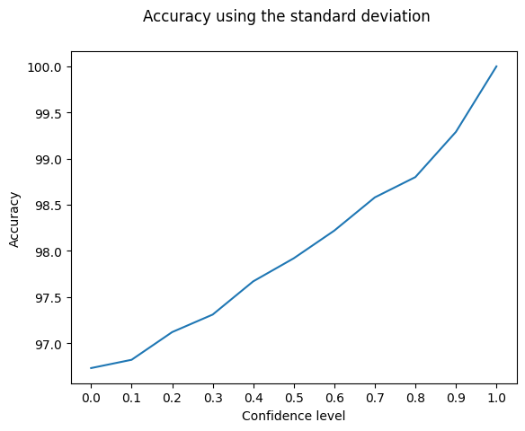
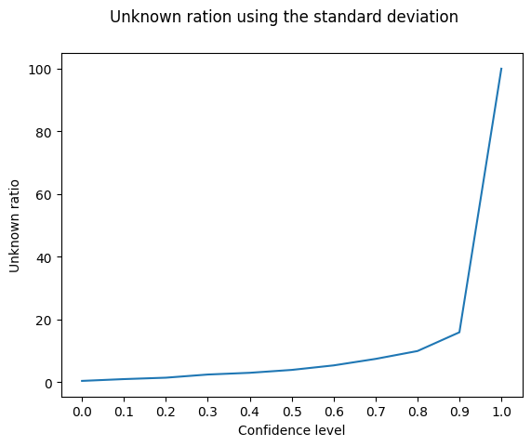
Standard deviation
$$threshold=2.87(1−conf_level)$$

Slide 12
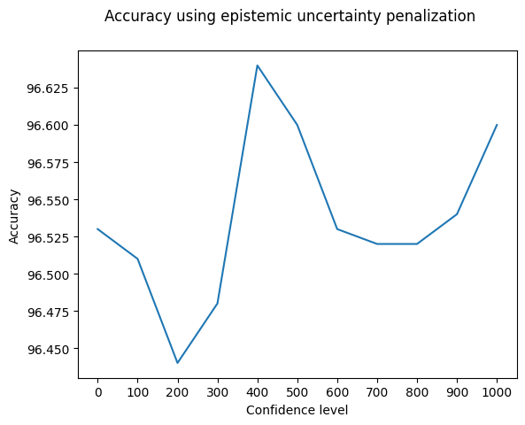
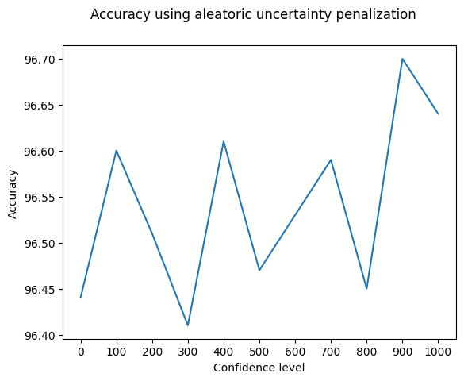
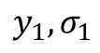
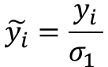
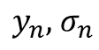
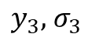
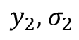
Uncertainty penalization
Output layer
First L-1 layers
$$y_{1}, σ_{1}$$
$$y_{2},{ σ}_{2}$$
$$\tilde{y_{i}}=\frac{y_{i}}{σ_{1} }$$
...
$$y_{3},{ σ}_{3}$$
$$y_{n},{ σ}_{n}$$

Slide 13
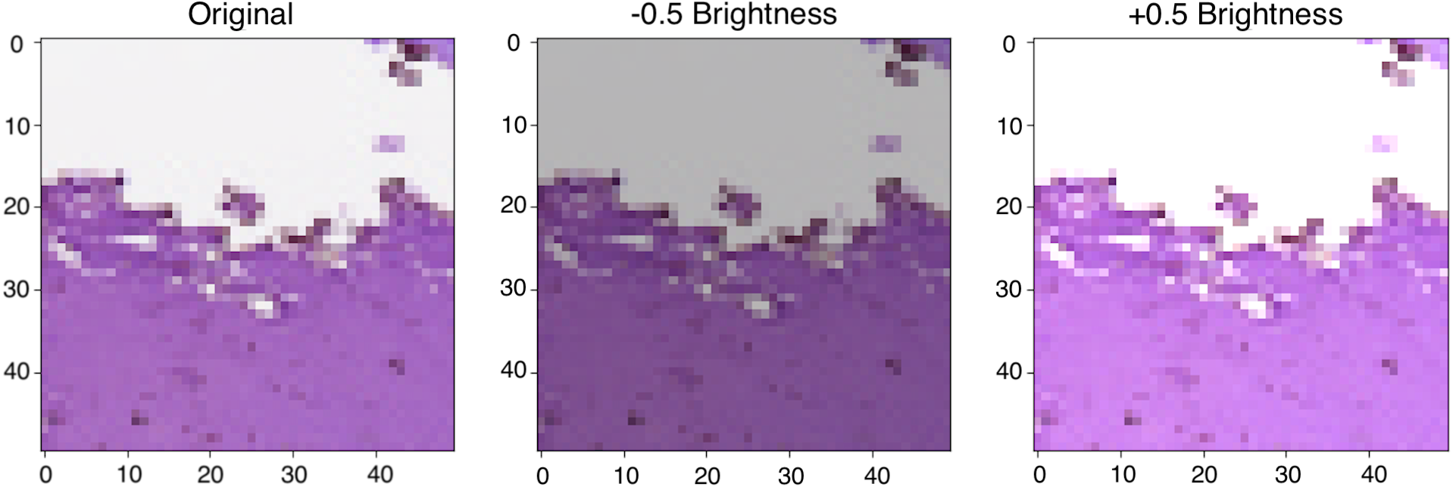
Alterations
An alteration of type A is a transformation of the input that mimics the possible effects over the inputs when a problem occurs
Given an alteration of type A, there is a range of plausible alterations of type A
Example: increase the brightness +- 10%, blur…
Alterations are defined by a domain expert
The same concept applies to other types of data: sounds, ..

Slide 14
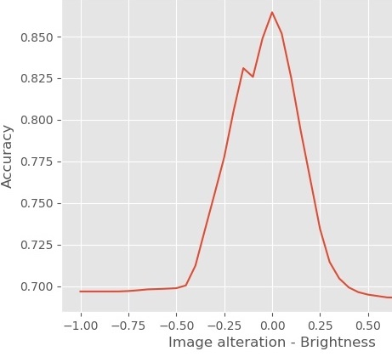
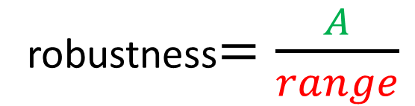
Robustness(1)
By altering the data, the accuracy (% of samples correctly labeled) decreases
The accuracy should not go below a given threshold
accuracy
The accuracy is above the desired threshold
threshold
robustness$=\frac{A}{range}$
A
Robustness = 1 means that the accuracy is always above the threshold
alteration
range

Slide 15
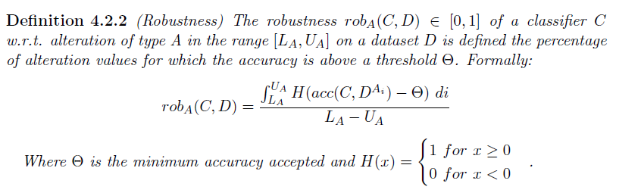
Robustness (2)
Limitations?
It does not measure how much above the threshold
We can use a different function, but which one?

Slide 16
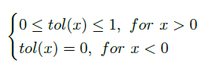
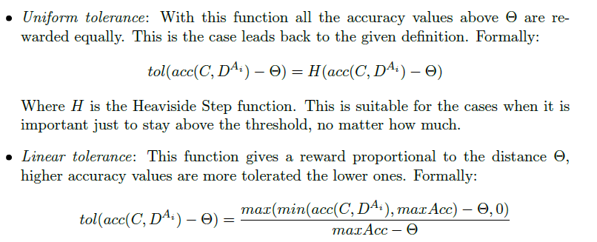
Tolerance
Some examples:

Slide 17
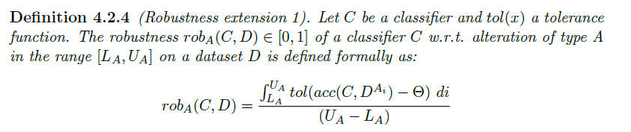
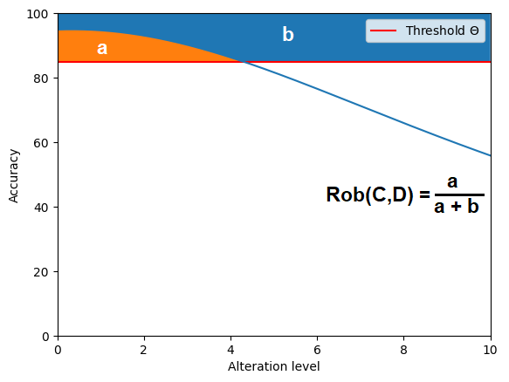
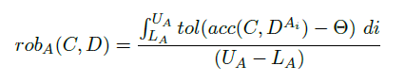
Robustness (3)

Slide 18
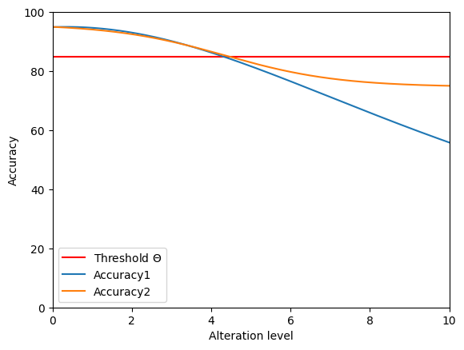
Robustness (4)
What happens after
the threshold?

Slide 19
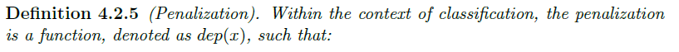
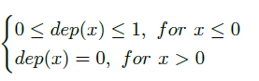
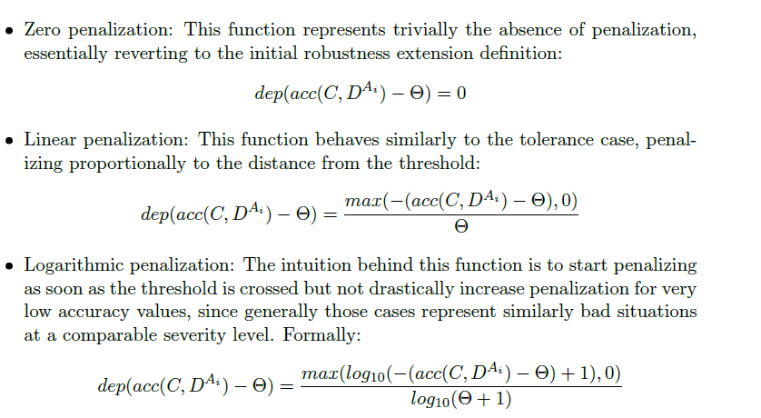
Penalization
Some examples:

Slide 20
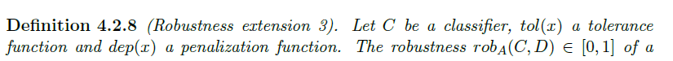
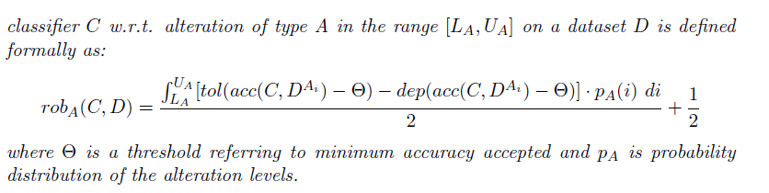
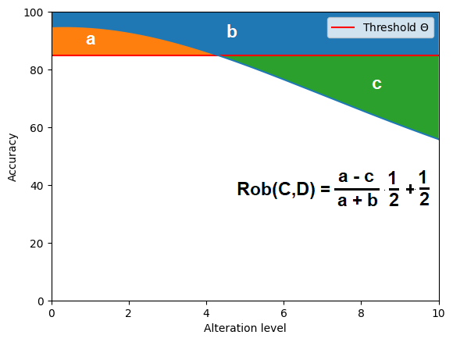
Robustness (5)

Slide 21

But where is the uncertainty?..

Slide 22

Robustness against indecision
So far we dealed with approaches applicable always
In fact, we can directly apply them using the accuracy of the BNN
The uncertainty is considered during the classification
But…
What if we have only unknown outputs?
The uncertainty would 100%
The network is useless!

Slide 23
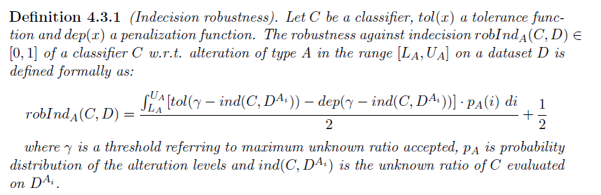
Robustness against indecision

Slide 24
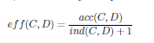
Can we combine the two metrics?
The idea is to combine the unknown ratio with the accuracy in someway to get a global metric
This new metric should reflect the accuracy When the network has an unknown ratio equal to zero;
When there are unknown predictions, it should be lower than the accuracy.
A first idea would be a ratio:
We call it effectiveness

Slide 25
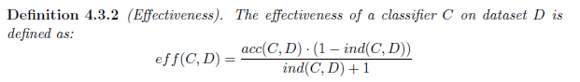
Effectiveness (1)
*The added factor serves to push the score to zero when only unknown are outputted

Slide 26
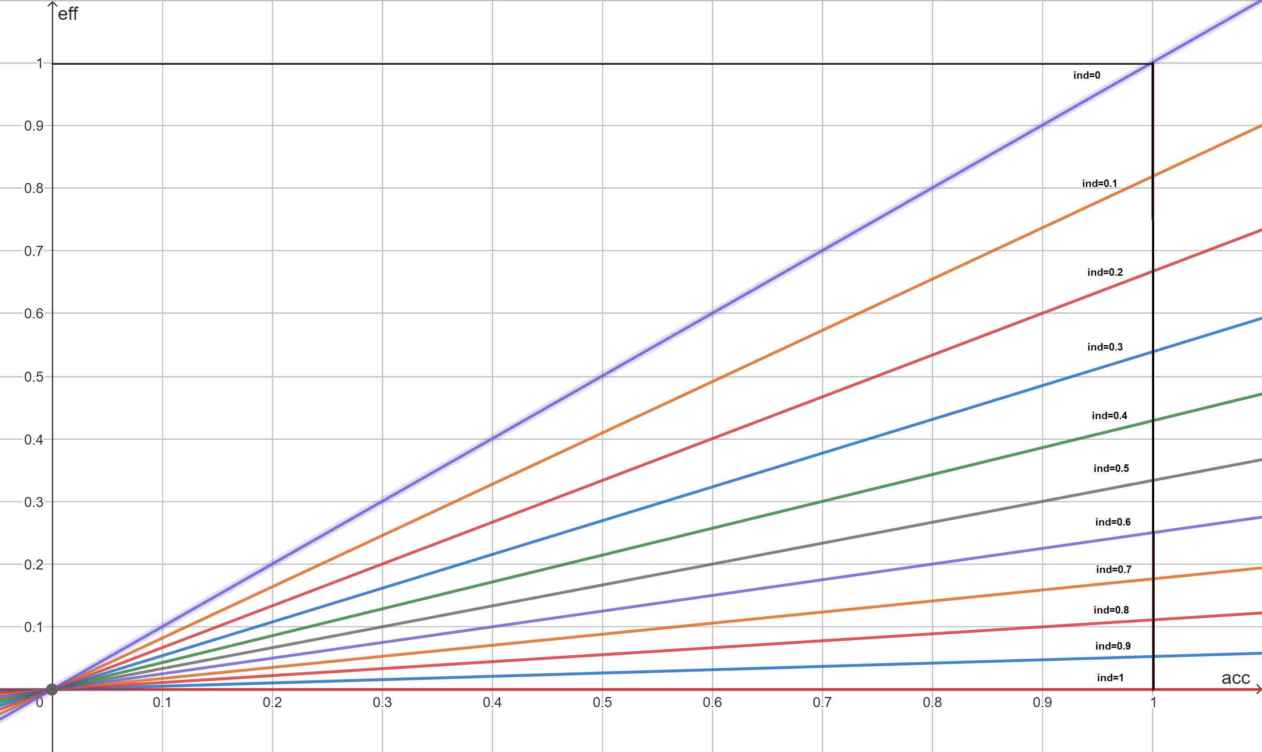
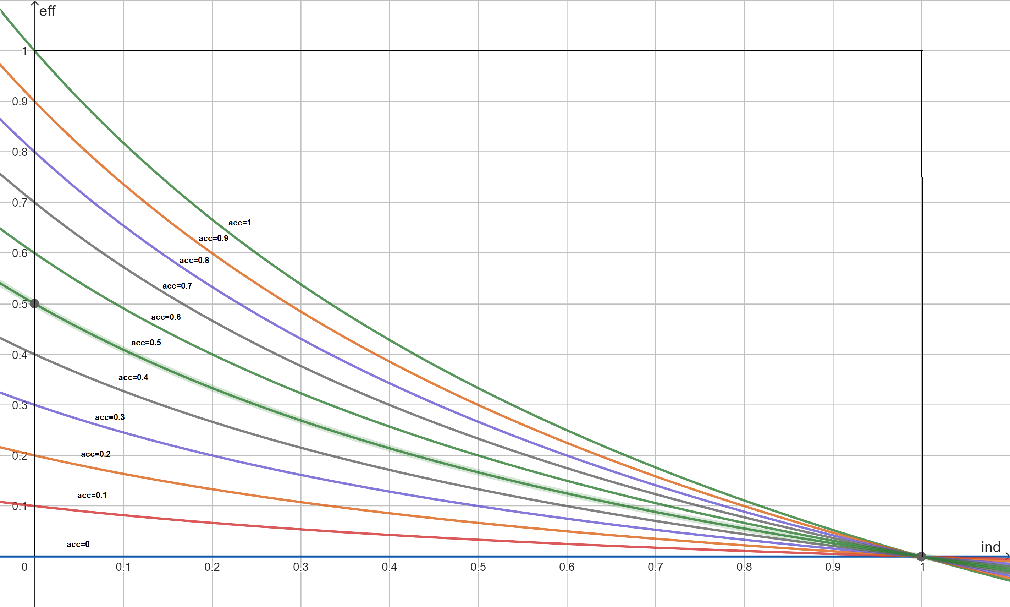
Effectiveness (2)

Slide 27
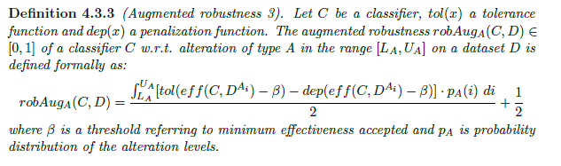
Effectiveness (3)

Slide 28
Some lessons learned
Uncertainty estimation can help in the reduction of wrong predictions and it is an inherent characteristic that improves the robustness;
When dealing with uncertainty, it is not enough to consider the accuracy as metric;
The uncertainty must be included in the evaluation.

Slide 29


Arigato
Gosaimasu

